Slide 1
Introduction to Computer Science: An Overview
by
Prof. Qazi Mazhar ul Haq
Office: R70926
Classroom: R70112
Email: qazi@saturn.yzu.edu.tw
Class timings: TUE 13:00 – 16:00
Office Hours: WED 09:00 – 12:00
TA: Mr. Darren
TA Email: dar030140@gmail.com

Slide 2
Grading
Homework grade | 20%
In-class Performance | 10%
Mid-term | 30%
Final Examination | 0%
Project | 40%
 | 0%
There will be short Quiz after every class
1-<number>

Slide 3
Course Schedule
Schedule | Topic
1 | Introduction
2 | Data Storage
3 | Data manipulation
4 | Program Data Manipulation
5 | Operating System
6 | Database Systems
7 | Networking and Internet
8 | Algorithms
9 | mid-term examine
10 | Programming Languages
11 | Data Abstraction
12 | Software Engineering
13 | Artificial Intelligence
14 | Self Study Session of Project Presentation
15 | Self Study Session of Project Presentation
16 | Self Study Session of Project Presentation
1-<number>

Slide 4
Chapter 1:
Data Storage
Computer Science: An Overview
Twelfth Edition
by
J. Glenn Brookshear
Dennis Brylow

Slide 5
Chapter 1: Data Storage
1.1 Bits and Their Storage
1.2 Main Memory
1.3 Mass Storage
1.4 Representing Information as Bit Patterns
1.5 The Binary System
1-<number>

Slide 6
Chapter 1: Data Storage (continued)
1.6 Storing Integers
1.7 Storing Fractions
1.8 Data and Programming
1.9 Data Compression
1.10 Communications Errors
1-<number>

Slide 7
Bits and Bit Patterns
Bit: Binary Digit (0 or 1)
Bit Patterns are used to represent information
  Numbers
  Text characters
  Images
  Sound
  And others
1-<number>

Slide 8
Boolean Operations
Boolean Operation: An operation that manipulates one or more true/false values
Specific operations
  AND
  OR
  XOR (exclusive or)
  NOT
1-<number>

Slide 9
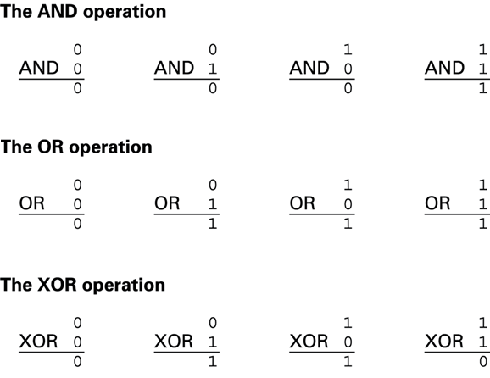
Figure 1.1 The possible input and output values of Boolean operations AND, OR, and XOR (exclusive or)
1-<number>

Slide 10
Gates
Gate: A device that computes a Boolean operation
  Often implemented as (small) electronic circuits
  Provide the building blocks from which computers are constructed
  VLSI (Very Large Scale Integration)
1-<number>

Slide 11
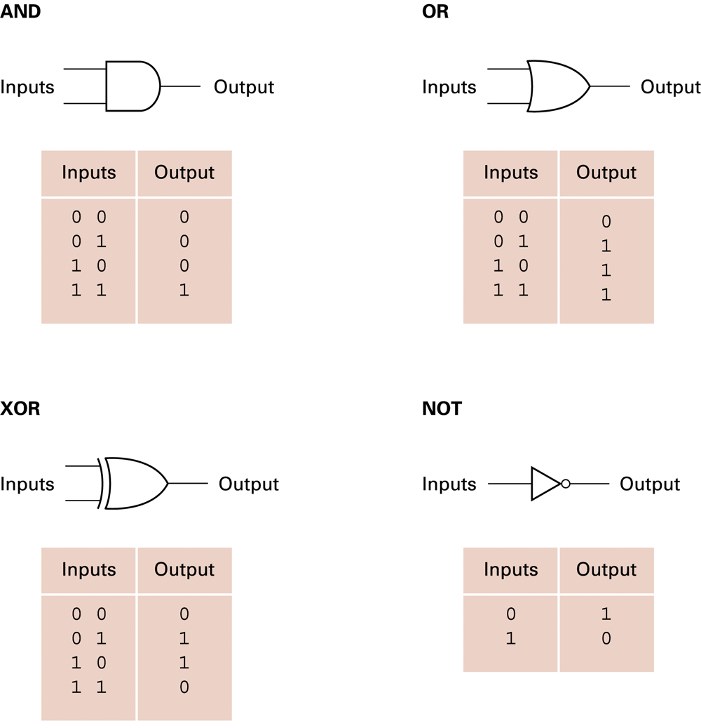
Figure 1.2 A pictorial representation of AND, OR, XOR, and NOT gates as well as their input and output values
1-<number>

Slide 12
Flip-flops
Flip-flop: A circuit built from gates that can store one bit.
  One input line is used to set its stored value to 1
  One input line is used to set its stored value to 0
  While both input lines are 0, the most recently stored value is preserved
1-<number>

Slide 13
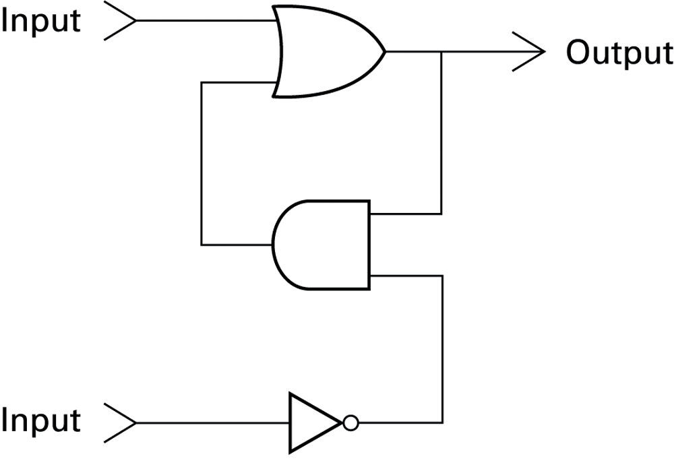
Figure 1.3 A simple flip-flop circuit
1-<number>

Slide 14
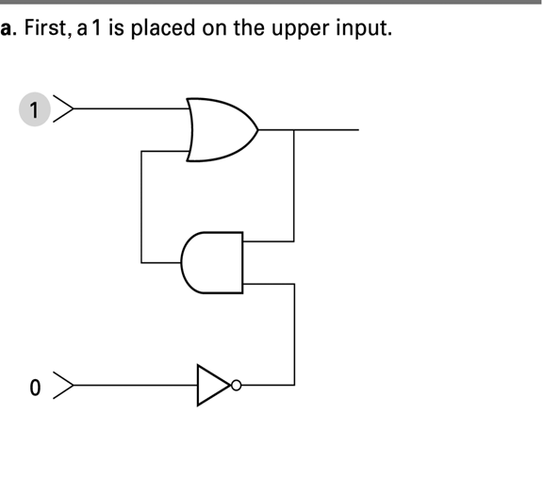
Figure 1.4 Setting the output of a flip-flop to 1
1-<number>

Slide 15
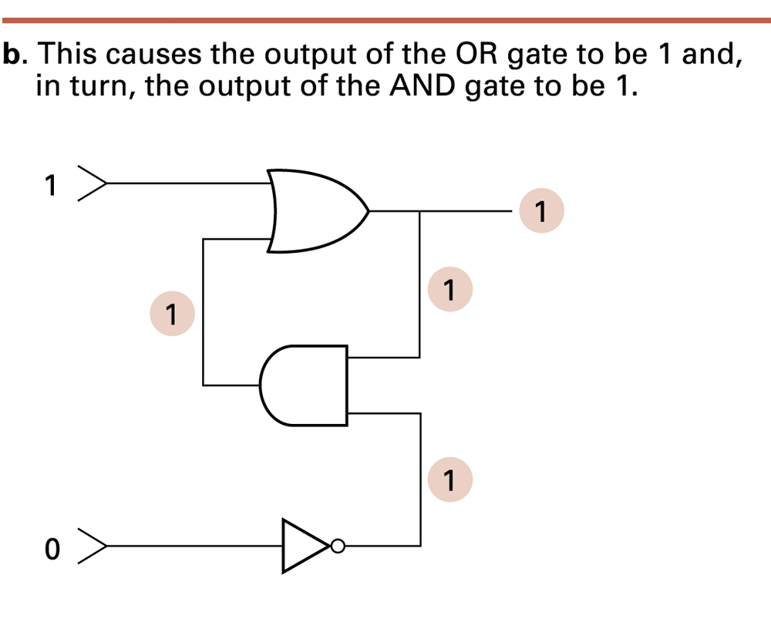
Figure 1.4 Setting the output of a flip-flop to 1 (continued)
1-<number>

Slide 16
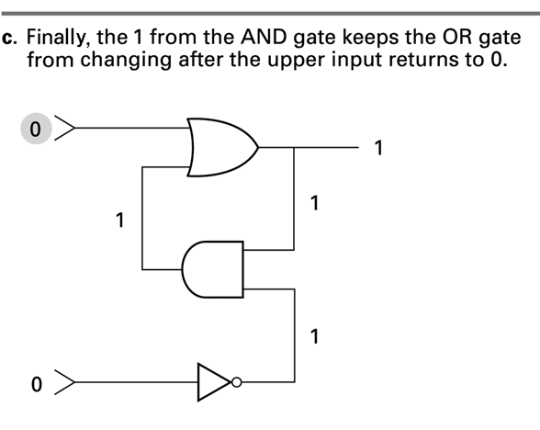
Figure 1.4 Setting the output of a flip-flop to 1 (continued)
1-<number>

Slide 17
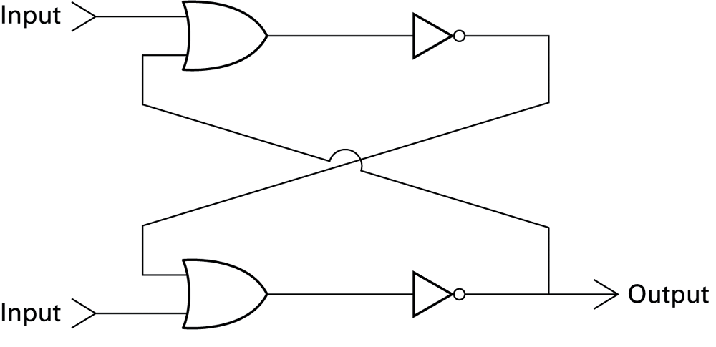
Figure 1.5 Another way of constructing a flip-flop
1-<number>

Slide 18
Hexadecimal Notation
Hexadecimal notation: A shorthand notation for long bit patterns
  Divides a pattern into groups of four bits each
  Represents each group by a single symbol
Example: 10100011 becomes A3
1-<number>

Slide 19
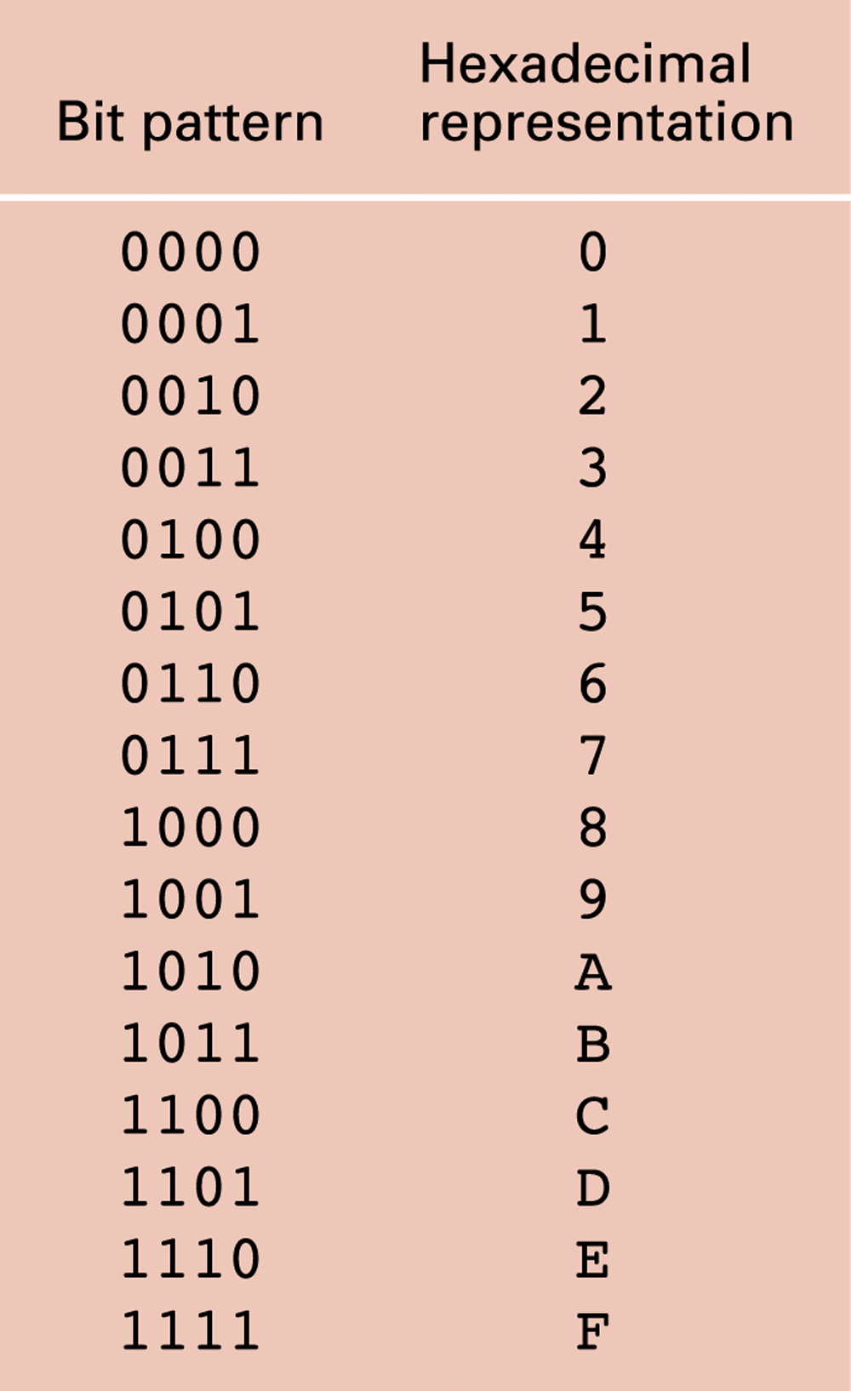
Figure 1.6 The hexadecimal coding system
1-<number>

Slide 20
Main Memory Cells
Cell: A unit of main memory (typically 8 bits which is one byte)
  Most significant bit: the bit at the left (high-order) end of the conceptual row of bits in a memory cell
  Least significant bit: the bit at the right (low-order) end of the conceptual row of bits in a memory cell
1-<number>

Slide 21
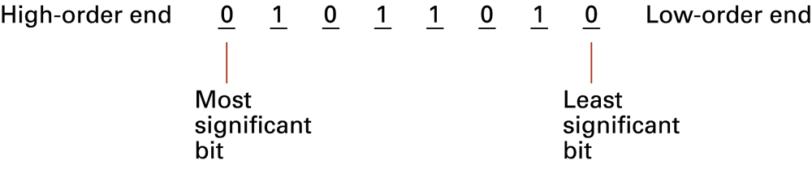
Figure 1.7 The organization of a byte-size memory cell
1-<number>

Slide 22
Main Memory Addresses
Address: A “name” that uniquely identifies one cell in the computer’s main memory
  The names are actually numbers.
  These numbers are assigned consecutively starting at zero.
  Numbering the cells in this manner associates an order with the memory cells.
1-<number>

Slide 23
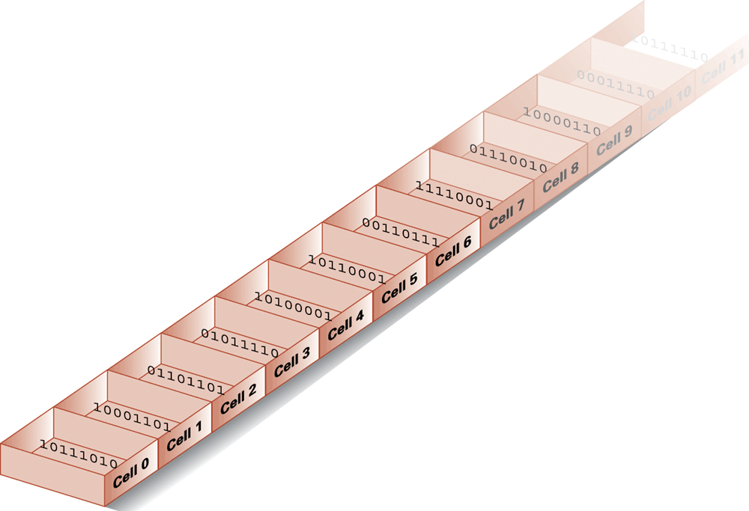
Figure 1.8 Memory cells arranged by address
1-<number>

Slide 24
Memory Terminology
Random Access Memory (RAM): Memory in which individual cells can be easily accessed in any order
Dynamic Memory (DRAM): RAM composed of volatile memory
1-<number>

Slide 25
Measuring Memory Capacity
Kilobyte: 2¹⁰ bytes = 1024 bytes
  Example: 3 KB = 3 times1024 bytes
Megabyte: 2²⁰ bytes = 1,048,576 bytes
  Example: 3 MB = 3 times 1,048,576 bytes
Gigabyte: 2³⁰ bytes = 1,073,741,824 bytes
  Example: 3 GB = 3 times 1,073,741,824 bytes
1-<number>

Slide 26
Mass Storage
Additional devices:
  Magnetic disks
  CDs
  DVDs
Advantages over main memory
  Less volatility
  Larger storage capacities
  Low cost
  In many cases can be removed
  Magnetic tape
  Flash drives
  Solid-state disks
1-<number>

Slide 27
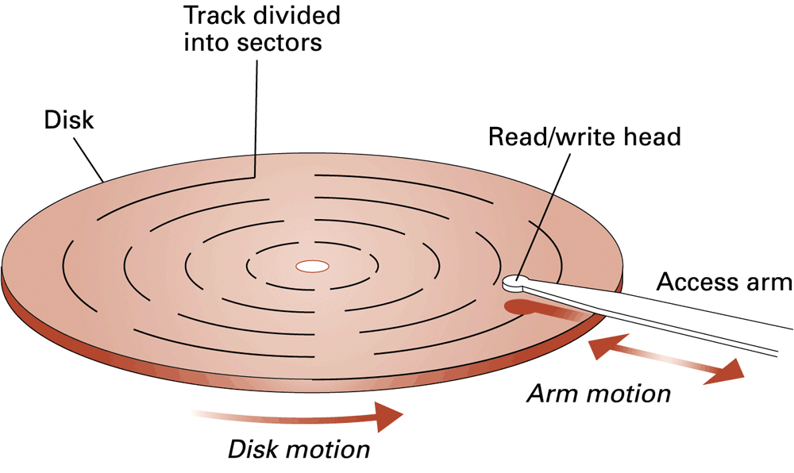
Figure 1.9 A magnetic disk storage system
1-<number>

Slide 28
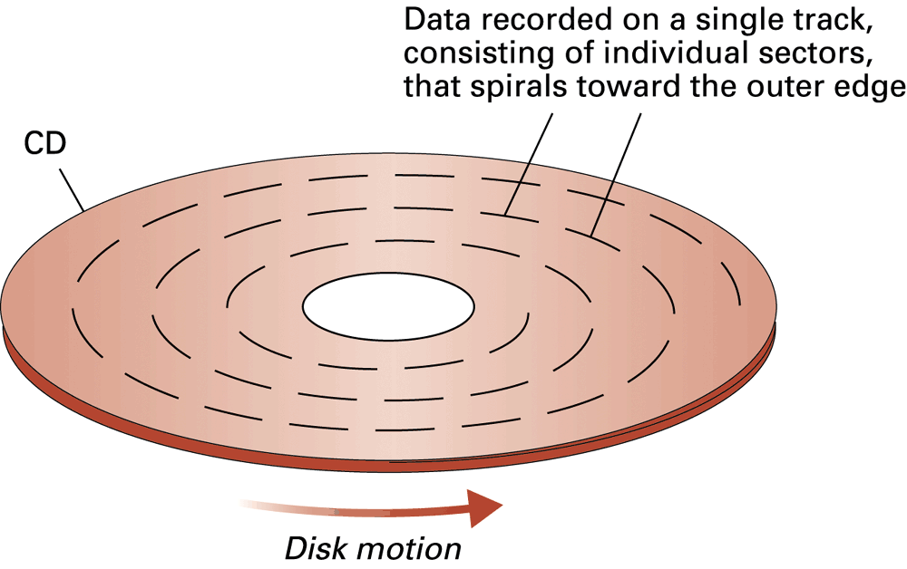
Figure 1.10 CD storage
1-<number>

Slide 29
Flash Drives
Flash Memory – circuits that traps electrons in tiny silicon dioxide chambers
Repeated erasing slowly damages the media
Mass storage of choice for:
  Digital cameras
SD Cards provide GBs of storage
  Smartphones
1-<number>

Slide 30
Representing Text
Each character (letter, punctuation, etc.) is assigned a unique bit pattern.
  ASCII: Uses patterns of 7-bits to represent most symbols used in written English text
  ISO developed a number of 8 bit extensions to ASCII, each designed to accommodate a major language group
  Unicode: Uses patterns up to 21-bits to represent the symbols used in languages world wide, 16-bits for world’s commonly used languages
1-<number>

Slide 31
Figure 1.11 The message “Hello.” in ASCII or UTF-8 encoding
1-<number>

Slide 32
Representing Numeric Values
Binary notation: Uses bits to represent a number in base two
Limitations of computer representations of numeric values
  Overflow: occurs when a value is too big to be represented
  Truncation: occurs when a value cannot be represented accurately
1-<number>

Slide 33
Representing Images
Bit map techniques
  Pixel: short for “picture element”
  RGB
  Luminance and chrominance
Vector techniques
  Scalable
  TrueType and PostScript
1-<number>

Slide 34
Representing Sound
Sampling techniques
  Used for high quality recordings
  Records actual audio
MIDI
  Used in music synthesizers
  Records “musical score”
1-<number>

Slide 35
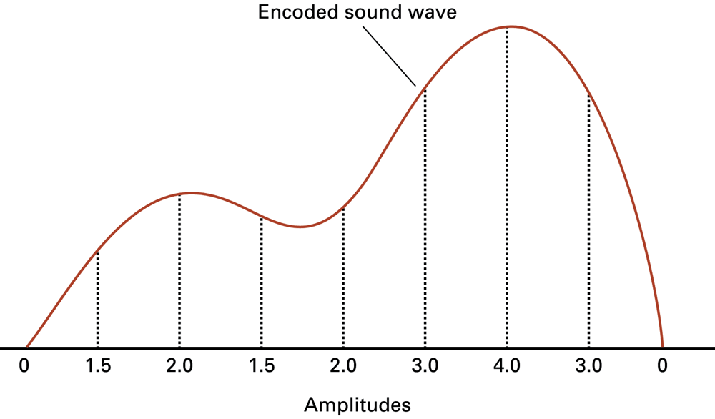
Figure 1.12 The sound wave represented by the sequence 0, 1.5, 2.0, 1.5, 2.0, 3.0, 4.0, 3.0, 0
1-<number>

Slide 36
The Binary System
The traditional decimal system is based
on powers of ten.
The Binary system is based on powers
of two.
1-<number>

Slide 37
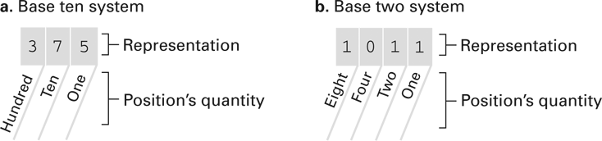
Figure 1.13 The base ten and binary systems
1-<number>

Slide 38
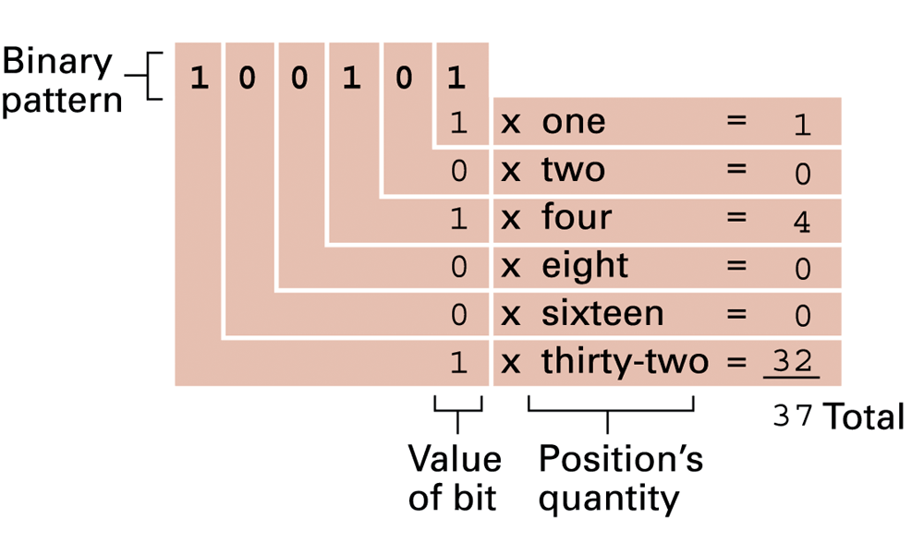
Figure 1.14 Decoding the binary representation 100101
1-<number>

Slide 39
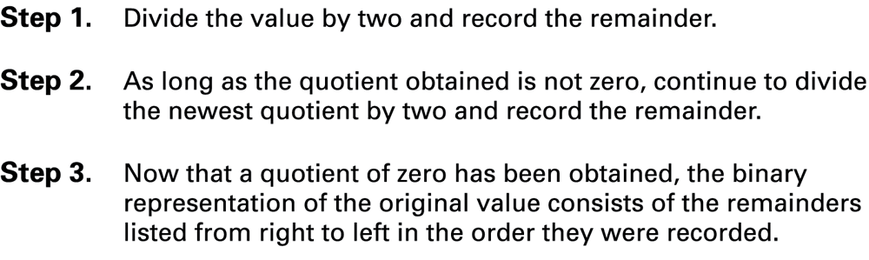
Figure 1.15 An algorithm for finding the binary representation of a positive integer
1-<number>

Slide 40
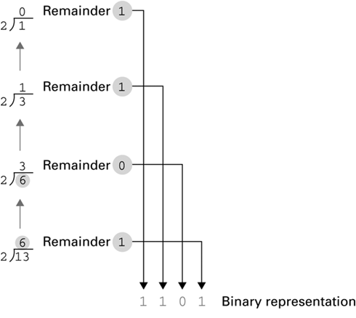
Figure 1.16 Applying the algorithm in Figure 1.15 to obtain the binary representation of thirteen
1-<number>

Slide 41
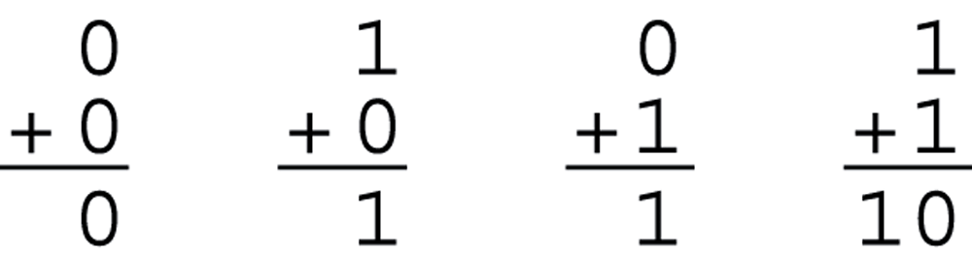
Figure 1.17 The binary addition facts
1-<number>

Slide 42
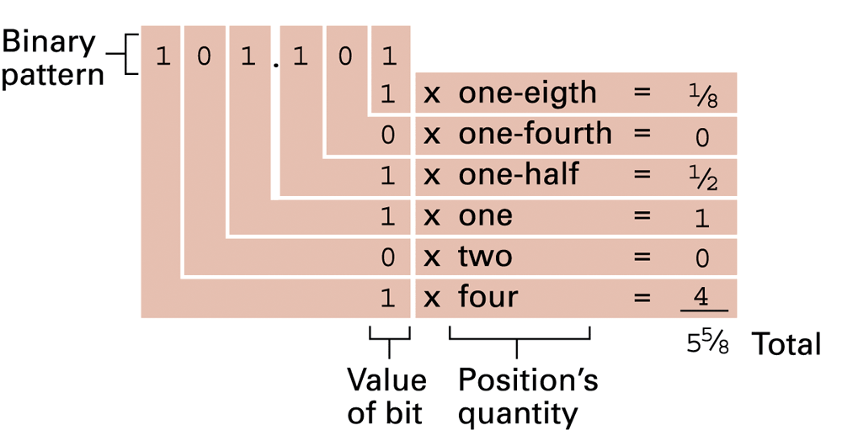
Figure 1.18 Decoding the binary representation 101.101
1-<number>

Slide 43
Storing Integers
Two’s complement notation: The most popular means of representing integer values
Excess notation: Another means of representing integer values
Both can suffer from overflow errors
1-<number>

Slide 44
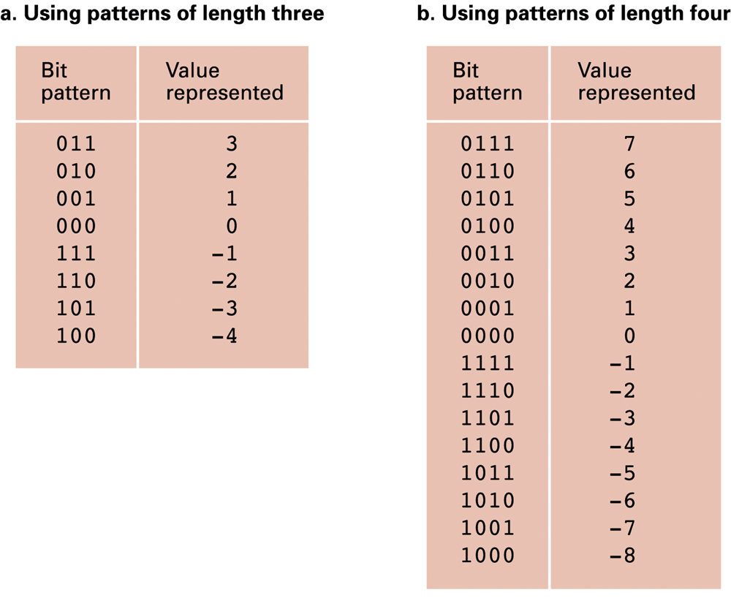
Figure 1.19 Two’s complement notation systems
1-<number>

Slide 45
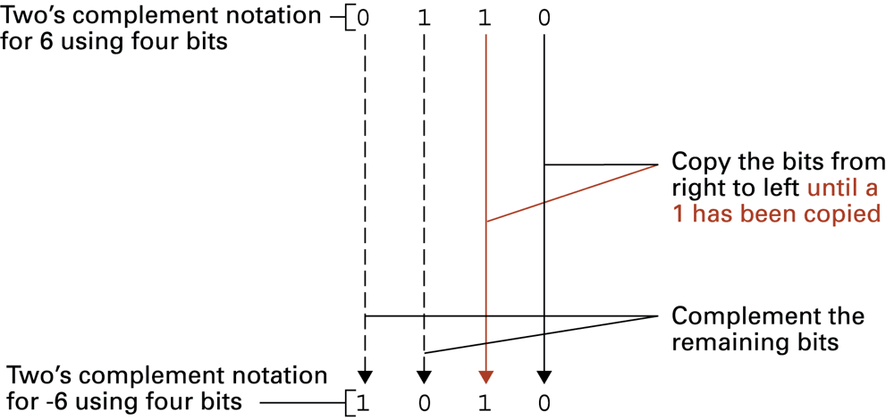
Figure 1.20 Coding the value -6 in two’s complement notation using four bits
1-<number>

Slide 46
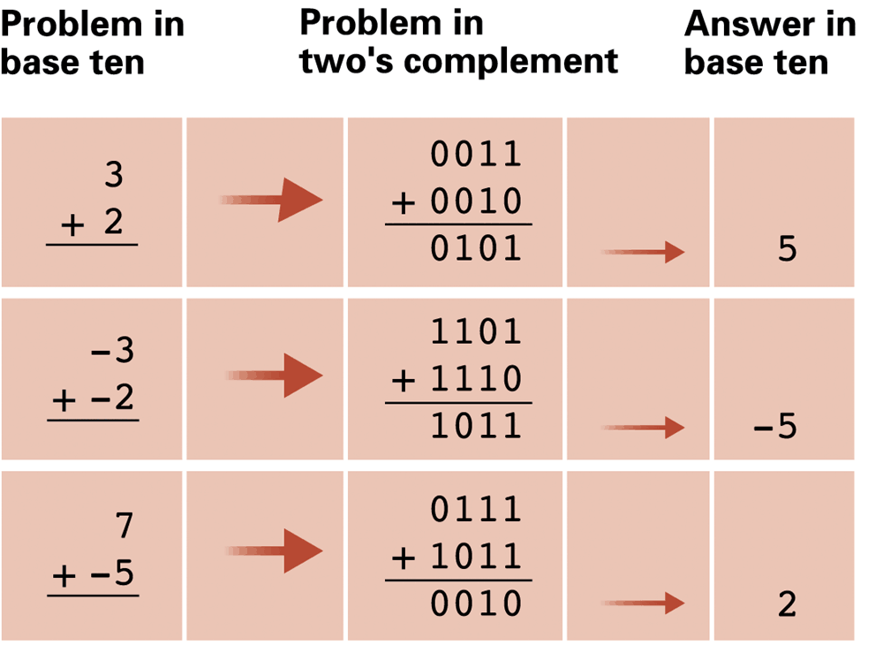
Figure 1.21 Addition problems converted to two’s complement notation
1-<number>

Slide 47
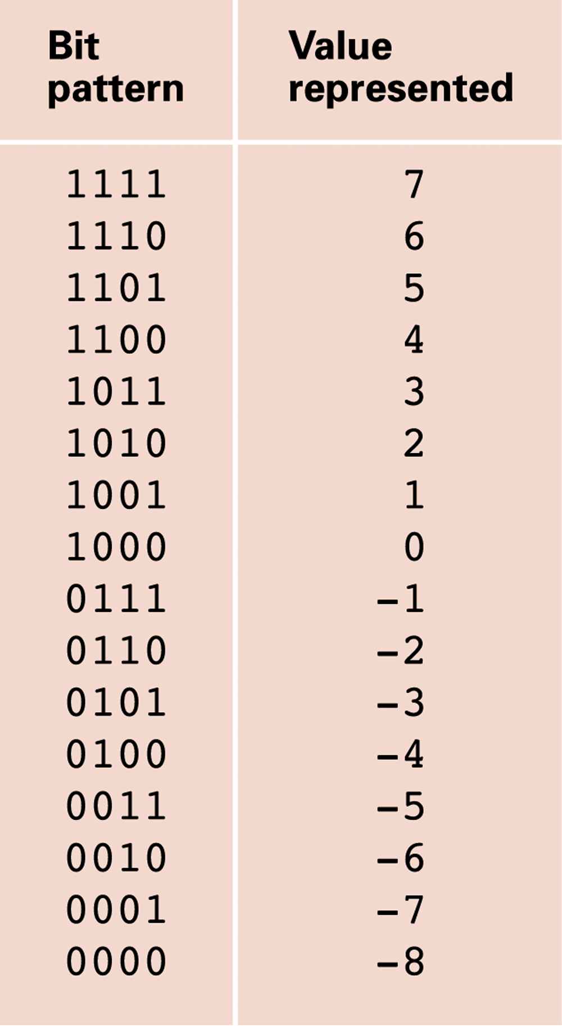
Figure 1.22 An excess eight conversion table
1-<number>

Slide 48
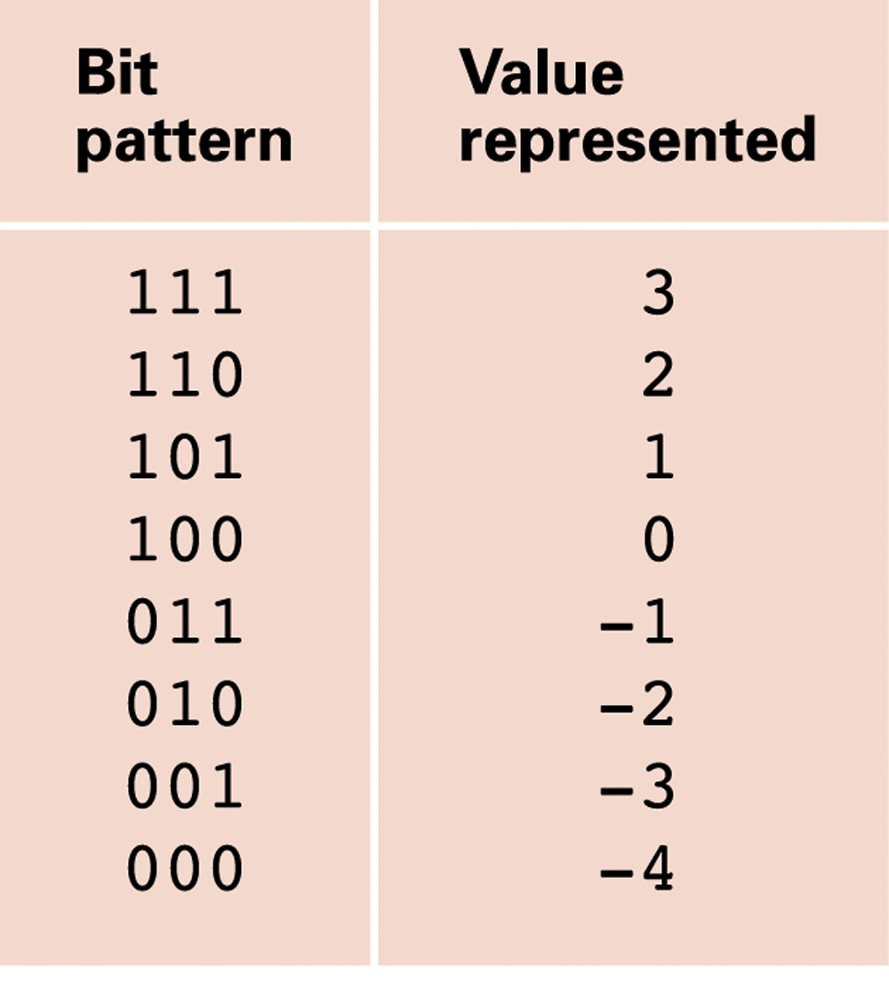
Figure 1.23 An excess notation system using bit patterns of length three
1-<number>

Slide 49
Storing Fractions
Floating-point Notation: Consists of a sign bit, a mantissa field, and an exponent field.
Related topics include
  Normalized form
  Truncation errors
1-<number>

Slide 50
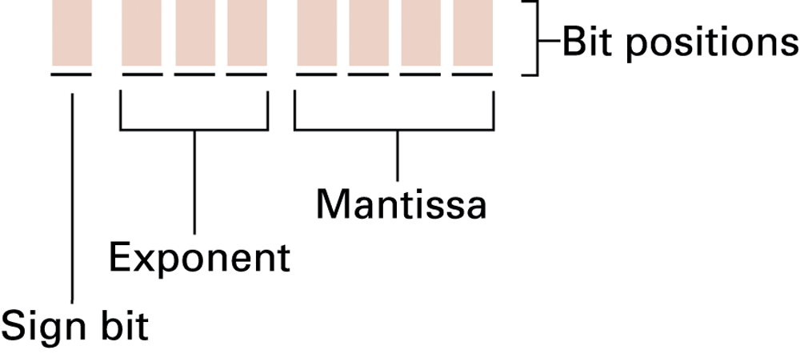
Figure 1.24 Floating-point notation components
1-<number>

Slide 51
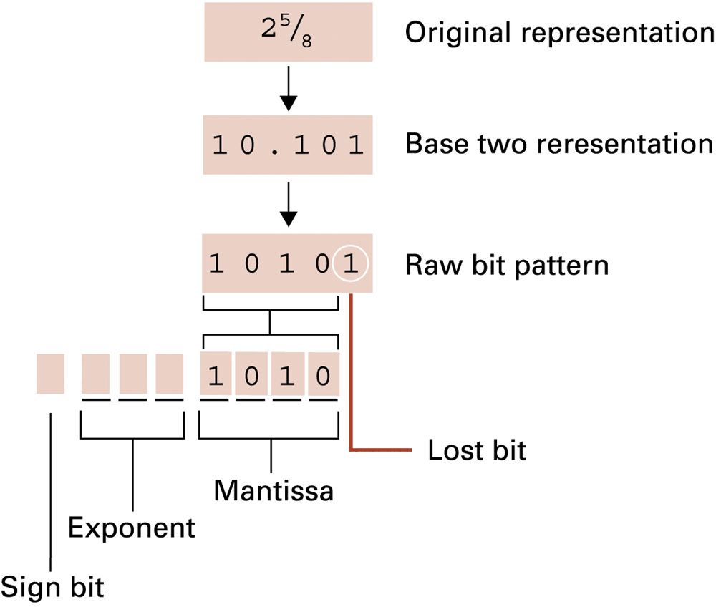
Figure 1.25 Encoding the value 2 ⁵⁄₈
1-<number>

Slide 52
Data and Programing
A programming language is a computer system created to allow humans to precisely express algorithms using a higher level of abstraction.
1-<number>

Slide 53
Getting Started with Python
Python: a popular programming language for applications, scientific computation, and as an introductory language for students
Freely available from www.python.org
Python is an interpreted language
  Typing:
    print('Hello, World!')
  Results in:
  Hello, World!
1-<number>

Slide 54
Variables
Variables: name values for later use
Analogous to mathematic variables in algebra
    s = 'Hello, World!'
    print(s)
    my_integer = 5
    my_floating_point = 26.2
    my_Boolean = True
    my_string = 'characters'
    my_integer = 0xFF
1-<number>

Slide 55
Operators and Expressions
    print(3 + 4) # Prints 7
print(5 – 6) # Prints -1
print(7 * 8) # Prints 56
print(45 / 4) # Prints 11.25
print(2 ** 10) # Prints 1024
s = 'hello' + 'world'
s = s * 4
print(s)
1-<number>

Slide 56
Currency Conversion
# A converter for currency exchange.
USD_to_GBP = 0.66 # Today's exchange rate
GBP_sign = '\u00A3' # Unicode value for £
dollars = 1000 # Number dollars to convert
# Conversion calculations
pounds = dollars * USD_to_GBP
# Printing the results
print('Today, $' + str(dollars))
print('converts to ' + GBP_sign + str(pounds))
1-<number>

Slide 57
Debugging
Syntax errors
    print(5 +)
    SyntaxError: invalid syntax
    pront(5)
    NameError: name 'pront' is not defined
Semantic errors
  Incorrect expressions like
  total_pay = 40 + extra_hours * pay_rate
Runtime errors
  Unintentional divide by zero
1-<number>

Slide 58
Data Compression
Lossy versus lossless
Run-length encoding
Frequency-dependent encoding
(Huffman codes)
Relative encoding
Dictionary encoding (Includes adaptive dictionary encoding such as LZW encoding.)
1-<number>

Slide 59
Compressing Images
GIF: Good for cartoons
JPEG: Good for photographs
TIFF: Good for image archiving
1-<number>

Slide 60
Compressing Audio and Video
MPEG
  High definition television broadcast
  Video conferencing
MP3
  Temporal masking
  Frequency masking
1-<number>

Slide 61
Communication Errors
Parity bits (even versus odd)
Checkbytes
Error correcting codes
1-<number>

Slide 62
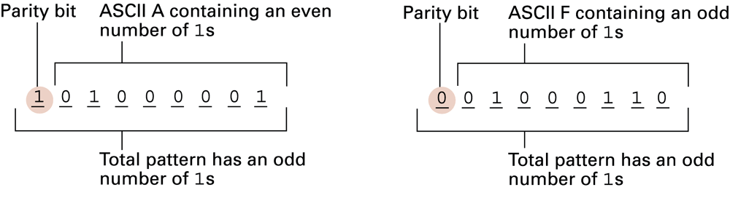
Figure 1.26 The ASCII codes for the letters A and F adjusted for odd parity
1-<number>

Slide 63
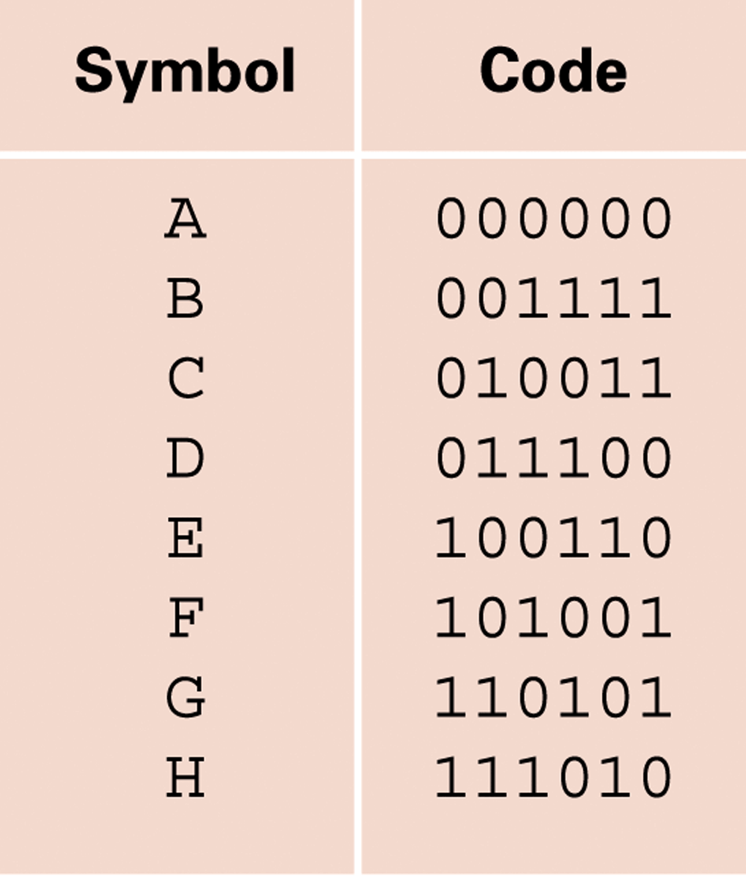
Figure 1.27 An error-correcting code
1-<number>

Slide 64
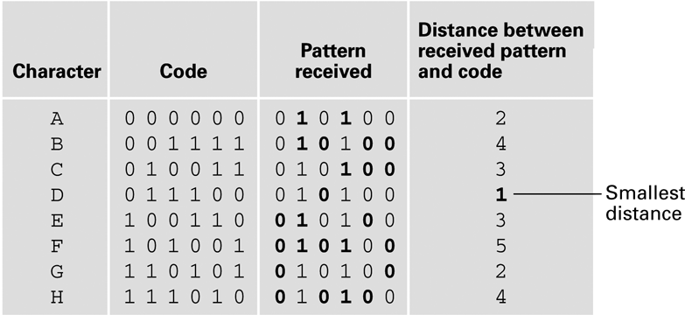
Figure 1.28 Decoding the pattern 010100 using the code in Figure 1.27
1-<number>

